Slide 1
Computer Organization & Assembly Language (CSC-205)
Lecture 7
Memory models, Flag register, Jump instructions

Slide 2
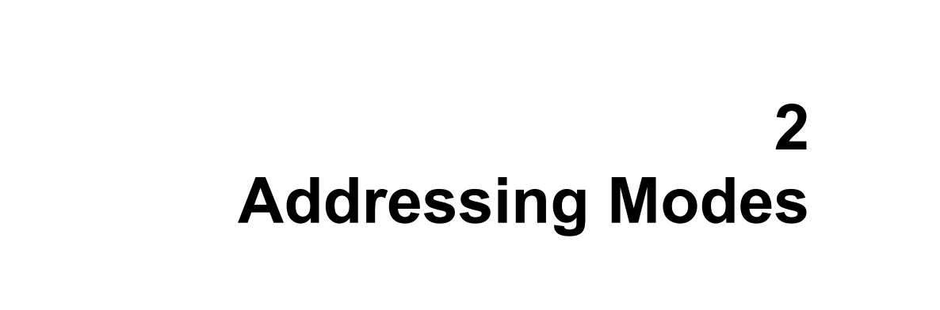

Slide 3
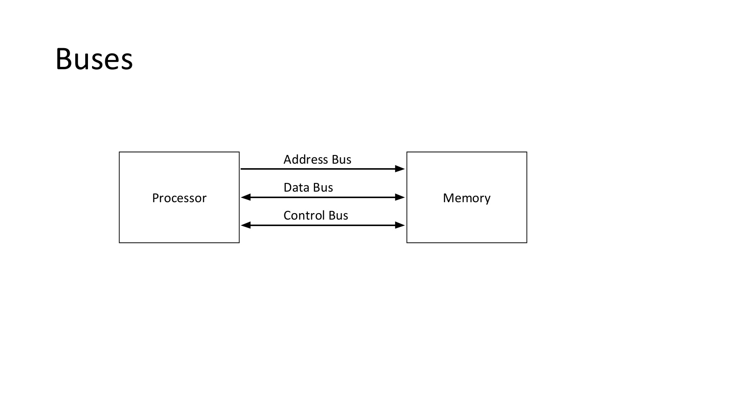

Slide 4
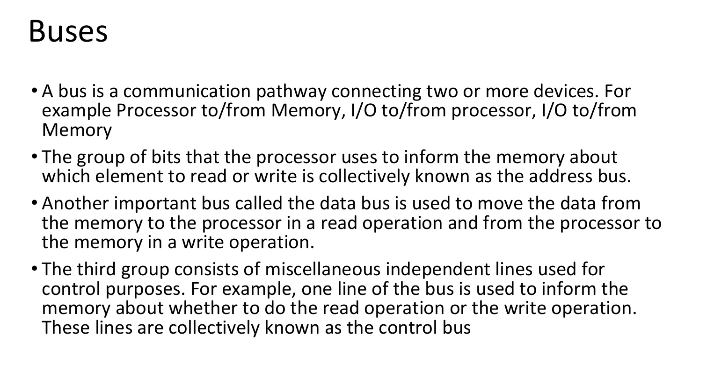

Slide 5
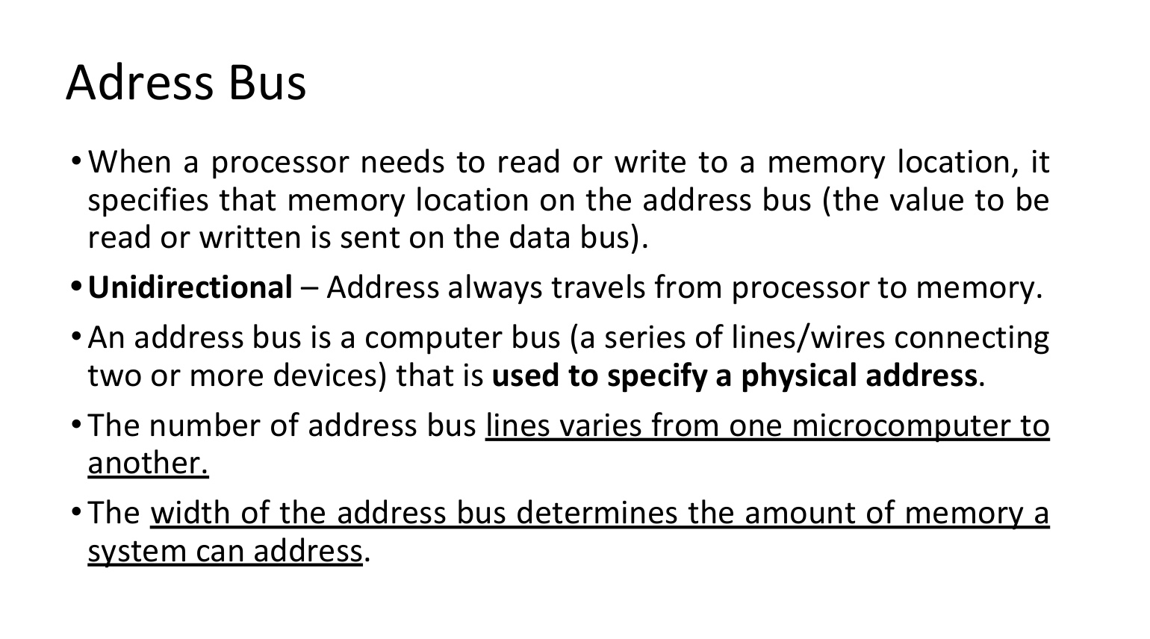

Slide 6
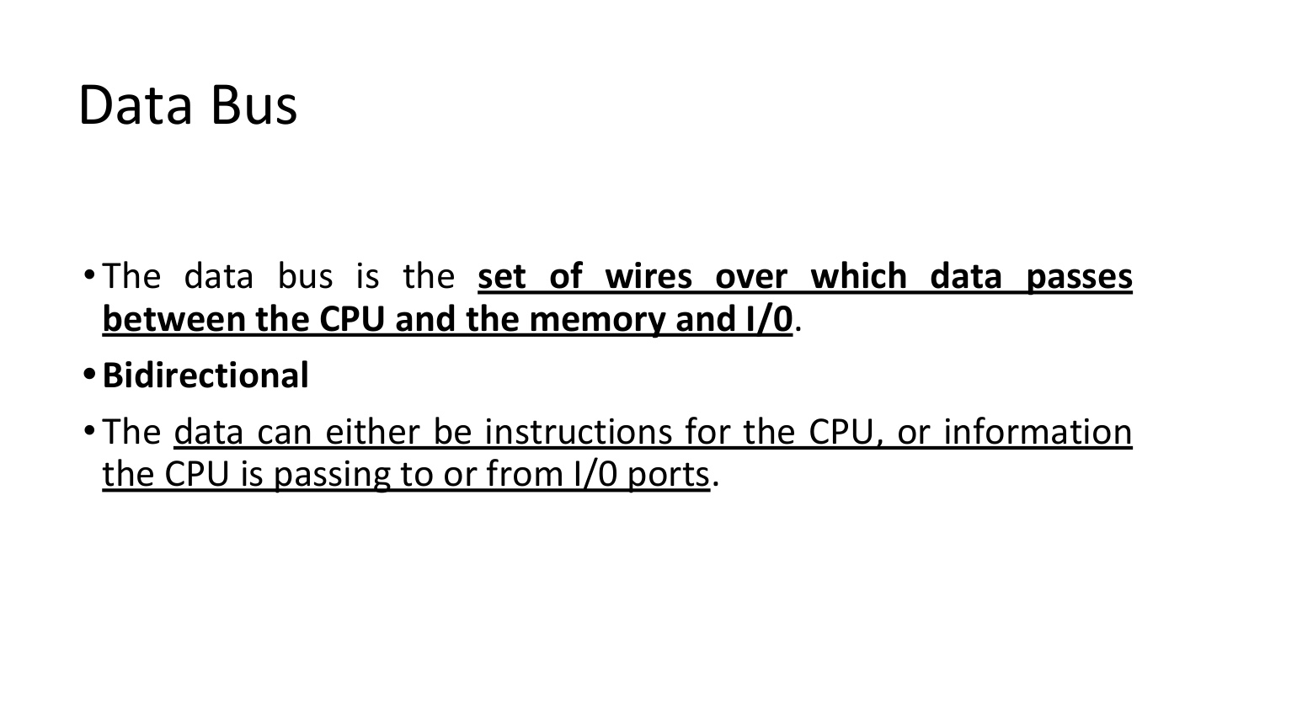

Slide 7
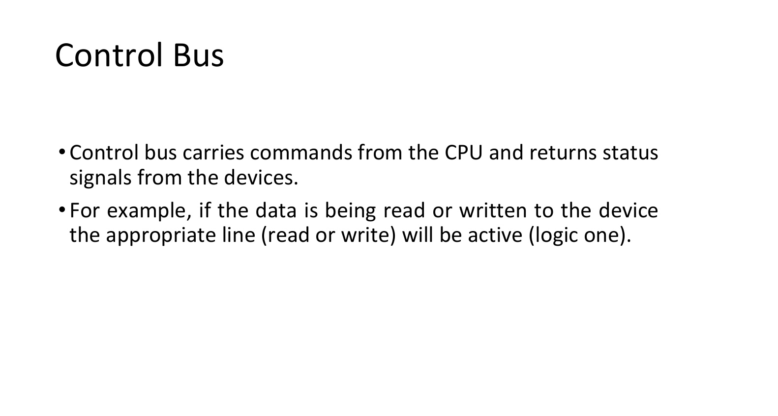

Slide 8
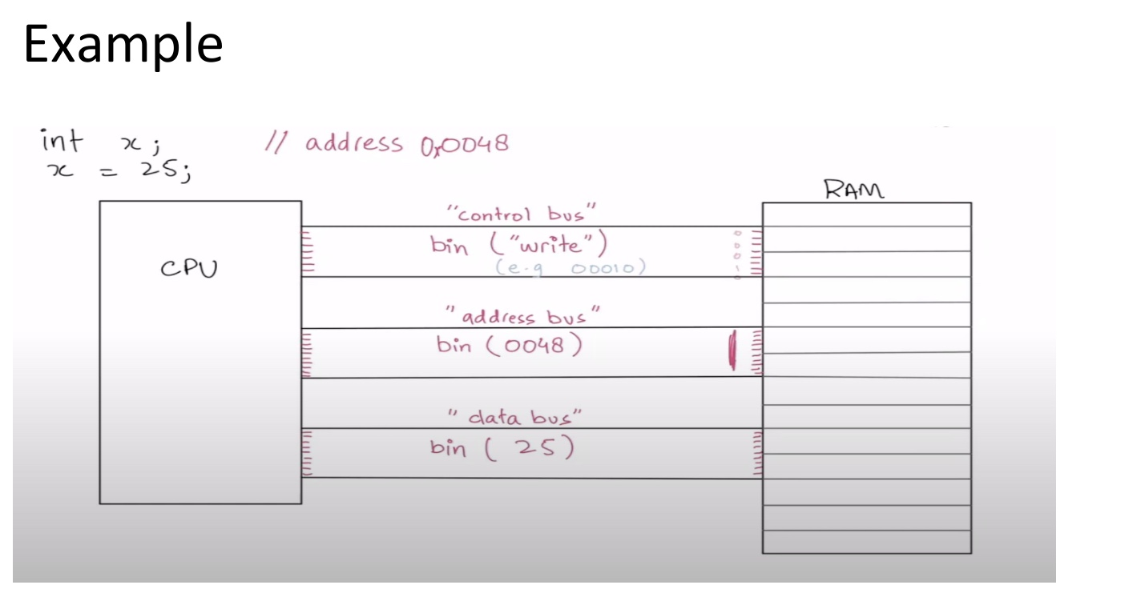

Slide 9
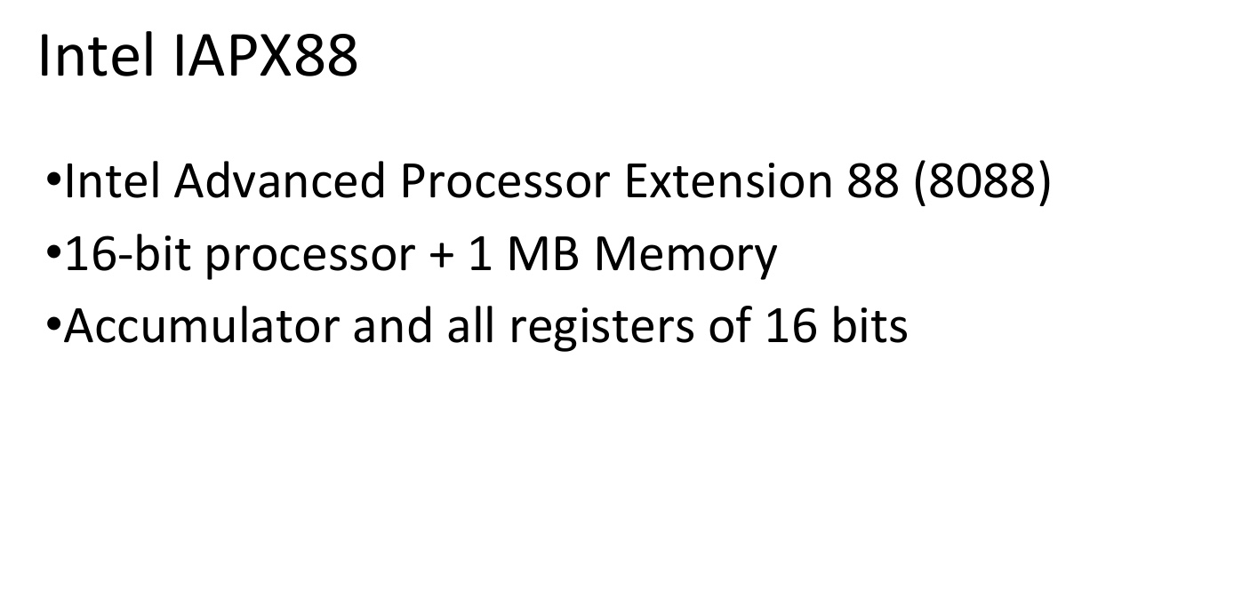

Slide 10
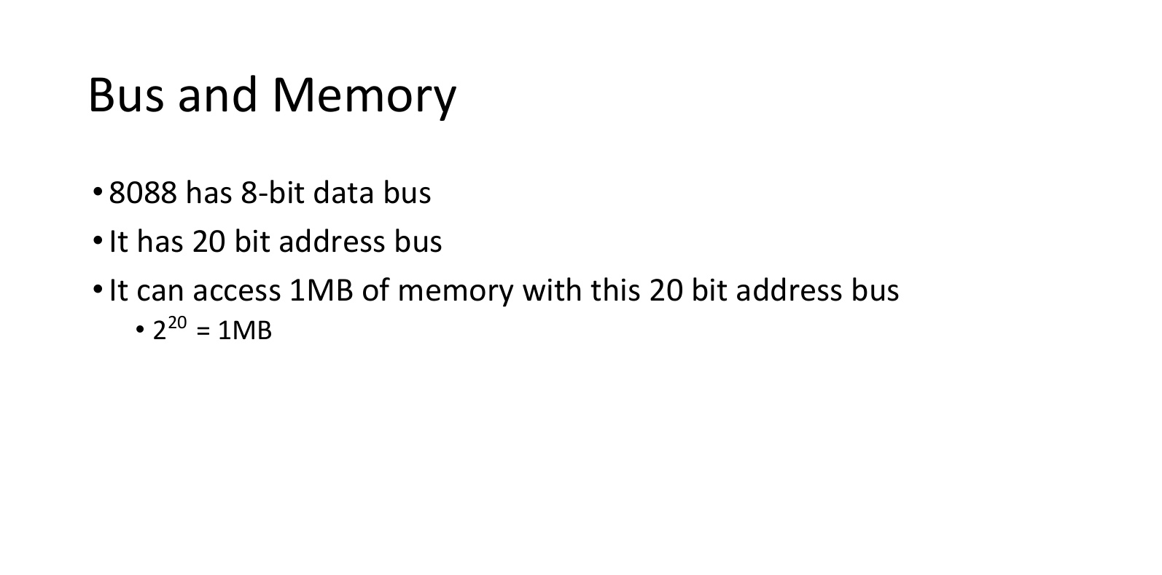

Slide 11
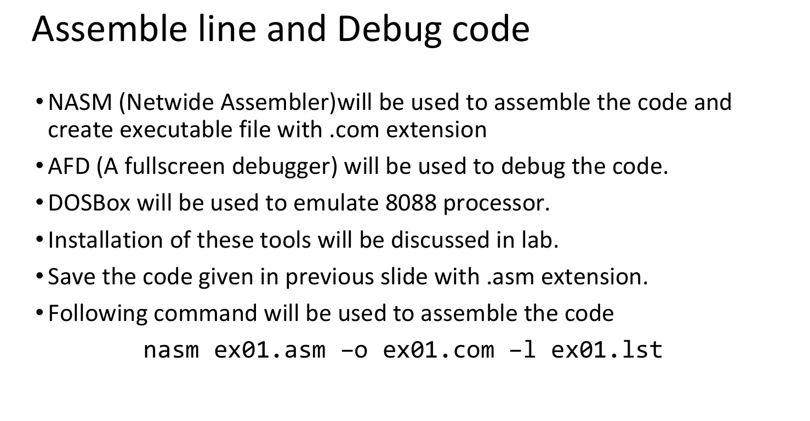

Slide 12
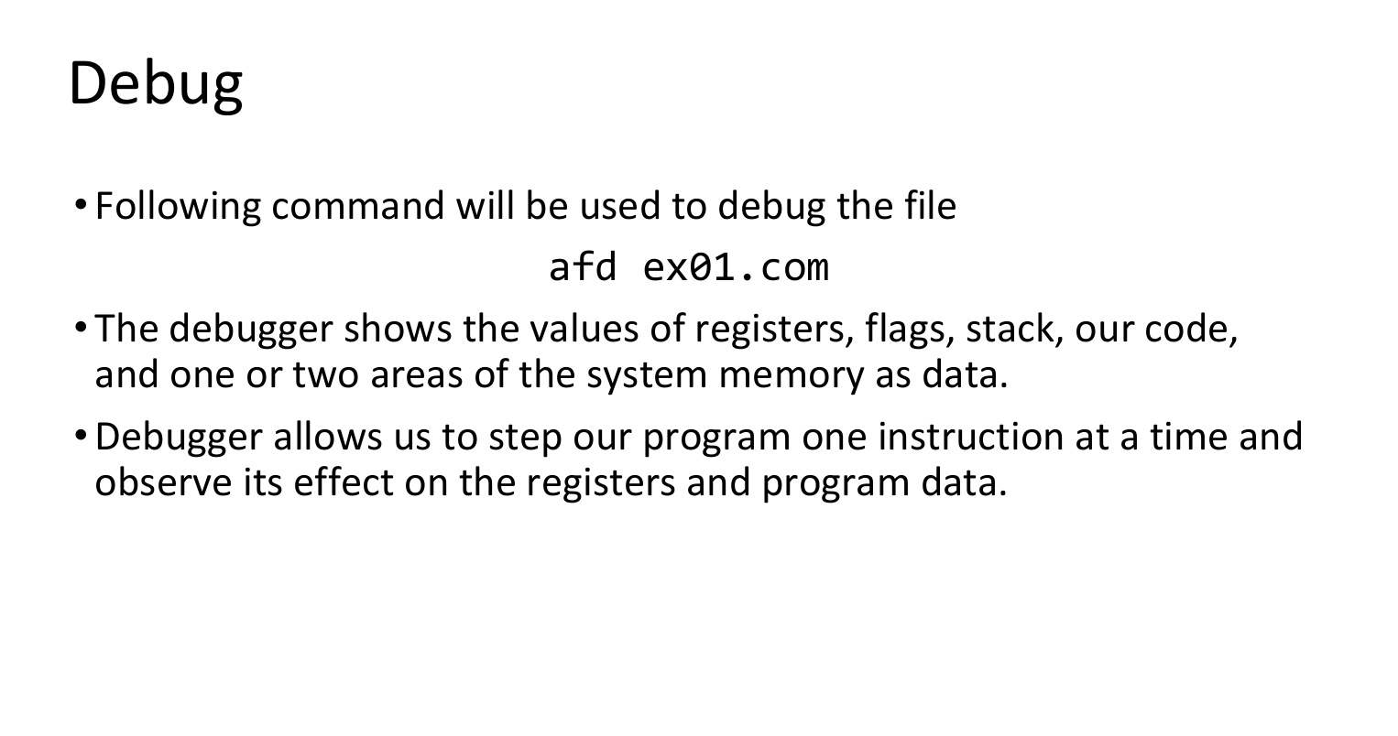

Slide 13
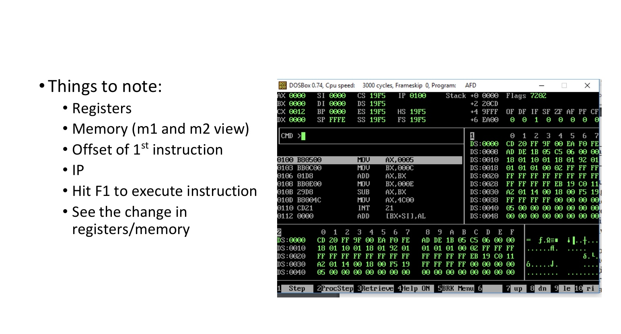

Slide 14
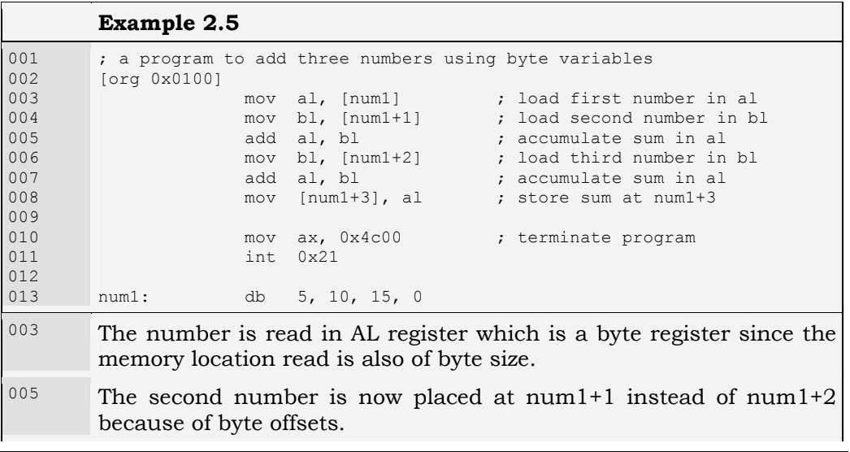

Slide 15
REGISTER INDIRECT ADDRESSING
We have done very elementary data access till now.
Assume that the numbers we had were 100 and not just three. This way of adding them will cost us 200 instructions.
There must be some method to do a task repeatedly on data placed in consecutive memory cells.
The key to this is the need for some register that can hold the address of data.
There are four registers in iAPX88 architecture that can hold address of data and they are BX, BP, SI, and DI. There are minute differences in their working which will be discussed later. For the current example, we will use the BX register and we will take just three numbers and extend the concept with more numbers in later examples.

Slide 16
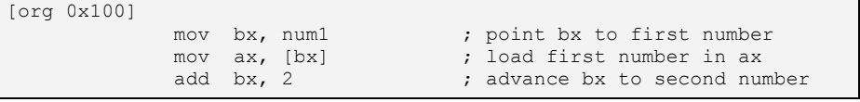
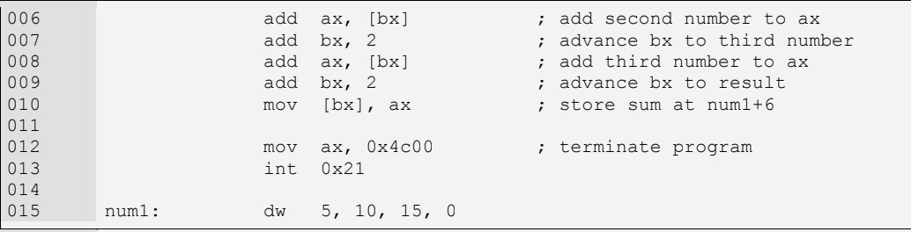

Slide 17
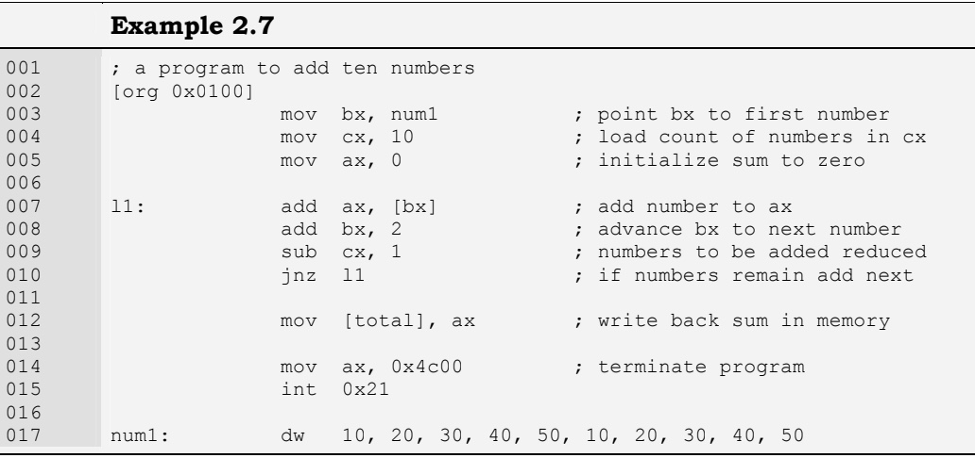
Next Example: A program to add ten numbers

Slide 18
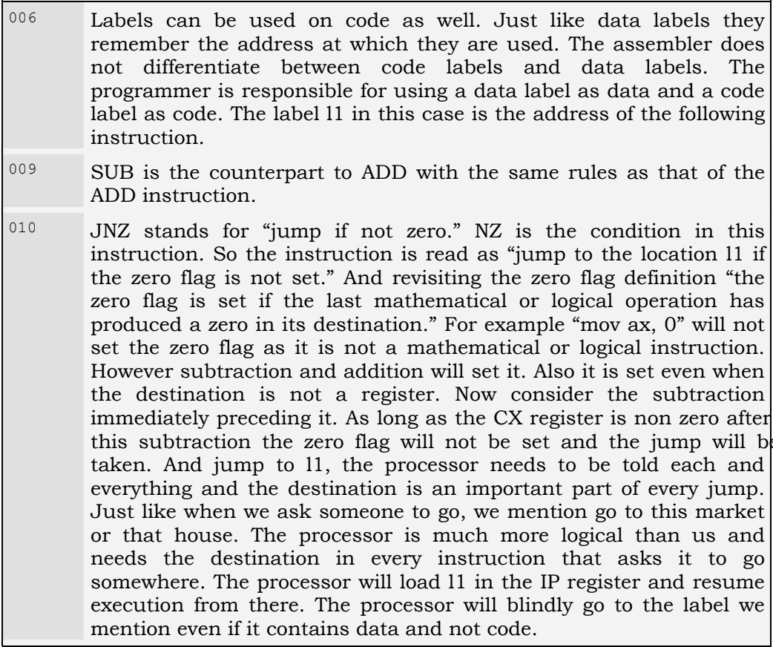
Explaination

Slide 19
2.5. REGISTER + OFFSET ADDRESSING
Direct addressing and indirect addressing using a single register are two basic forms of memory access. Another possibility is to use different combinations of direct and indirect references. In the above example we used BX to access different array elements which were placed consecutively in memory like an array. We can also place in BX only the array index and not the exact address and form the exact address when we are going to access the actual memory. This way the same register can be used for accessing different arrays and also the register can be used for index comparison like the following example does.

Slide 20
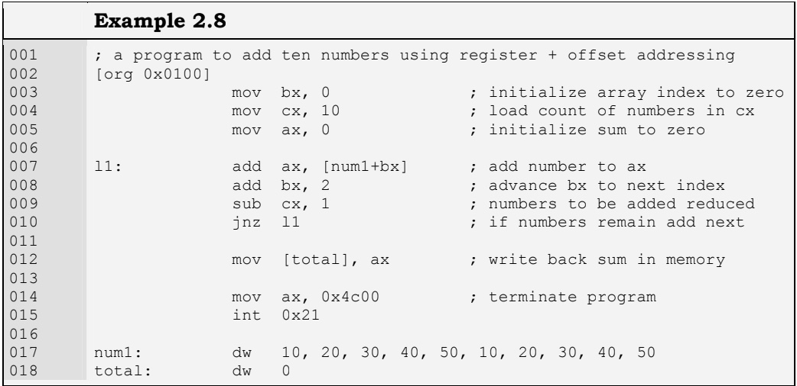
Next Example: A program to add ten numbers using register + offset addressing

Slide 21
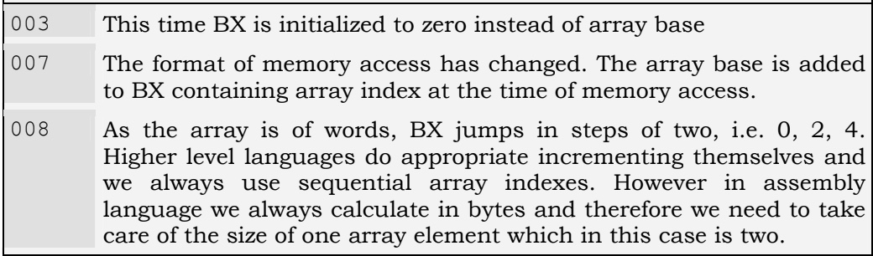
Explaination

Slide 22
End of Lecture

